Slide 1


Supply Chain Analysis
Fashion and Beauty Start-up
POWER BI

Slide 2
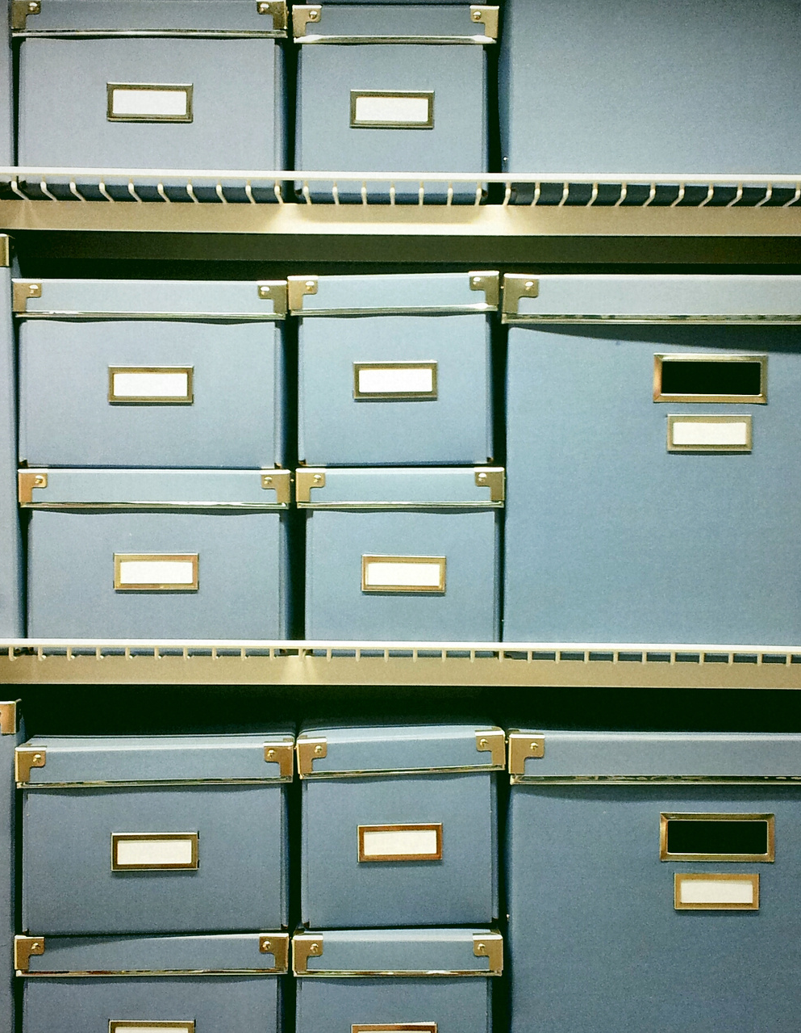
Introduction
Fashion and Beauty Start-up
Structured Data
Pre-calculated and defined data
24 Column
Data source:
Manufacturing
Transportation
Inventory
Logistics
Sales
Customer Demographics

Slide 3
Snapshot of Metadata
Product Type
3 distinct Values
Haircare
Skincare
Cosmetics
Shipping Carrier
3 distinct Values
Carrier A
Carrier B
Carrier C
Supplier
5 distinct Values
Supplier 1
Supplier 2
Supplier 3
Supplier 4
Supplier 5

Slide 4
Relevant Metadata
Location
5 distinct Values
Kolkata
Mumbai
Chennai
Bangalore
Delhi
Inspection Result
3 distinct Values
Pending
Fail
Pass
Transportation Modes
4 distinct Values
Road
Rail
Air
Sea
Routes
3 distinct Values
Route A
Route B
Route C

Slide 5
Analytical Goals
WHAT?
Product type drivers
Efficient Lead Time
Defects on Transportation

Slide 6
Analytical Goals
HOW?
Identify Trends
Lead Time
Reduce Defects
Notes:
We want to quantify, what do we need to do base on the data

Slide 7
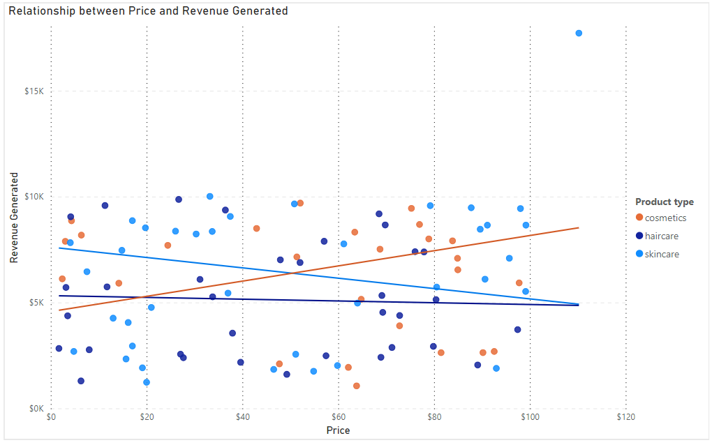
Positive Trend
Correlation between the revenue and skincare products.

Slide 8
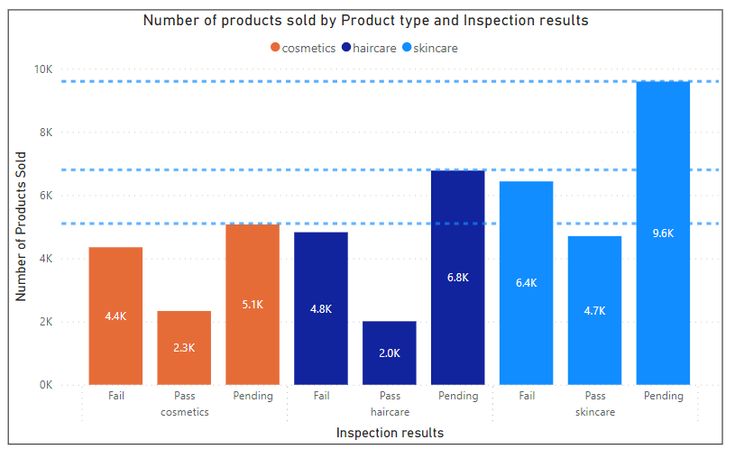
The Reason

Slide 9
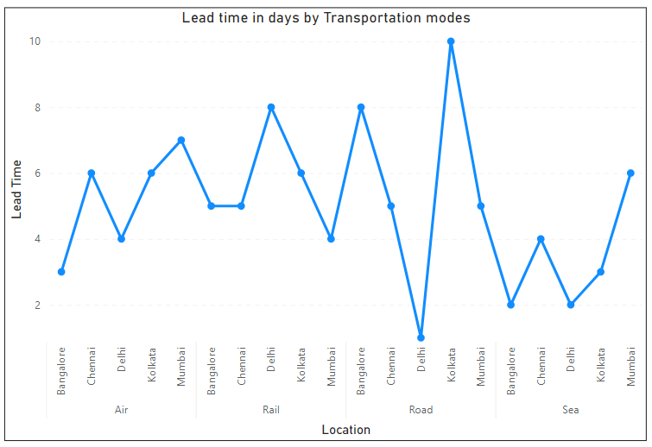
What? – Lead Time

Slide 10
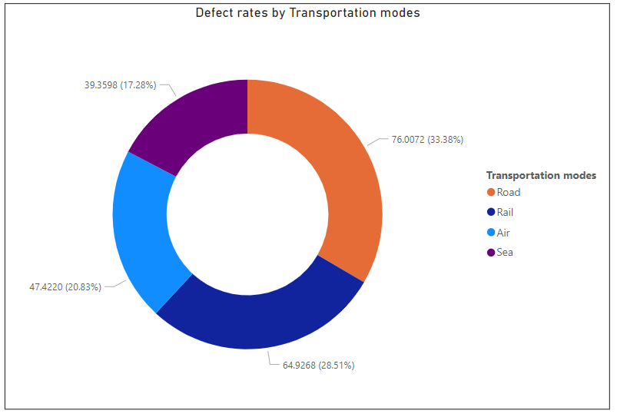
What? - Transportation

Slide 11
Insights
Location
Adapt the distribution of Products sold in different location
Categorize Transportation
Identify which transportation are best to ship type of Product
Increase Number of Products sold
Prioritize the inspection of cosmetic products

Slide 12
Summary
The company derives more revenue from skincare products
Carrier B helps the company in generating more revenue
Higher Defect rates on Road Transportation
The best route is transportation through see which yields faster lead time
The Number of Products Sold are still Pending
Notes:
1. 45% of the business comes from skincare products, 29.5% from haircare, and 25.5% from cosmetics.

Slide 13
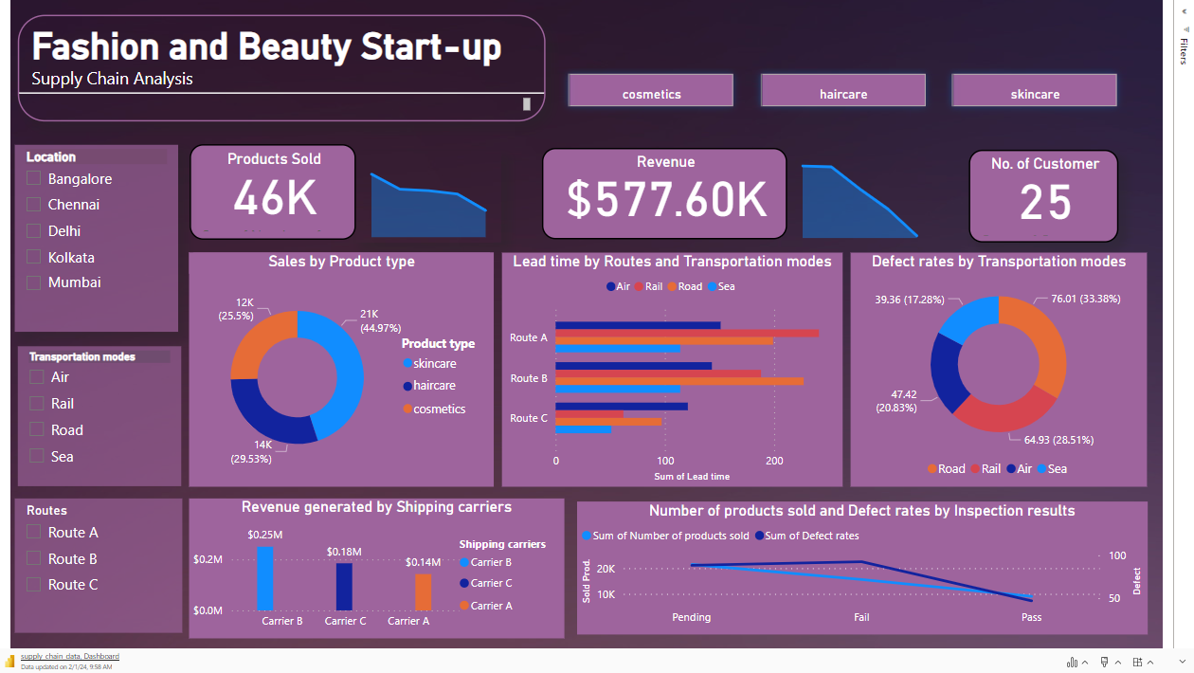

Slide 14
Further Exploration and Steps
Enhance the overall inspection of products and how might it affect the revenue
Strengthen partnerships from carriers concerning revenue
What’s the impact of building transportation hub to increase lead time

Slide 15
Reference
Kaggle:
https://www.kaggle.com/datasets/harshsingh2209/supply-chain-analysis
By: Harsh Singh
Other Sources:
https://thecleverprogrammer.com/2023/04/03/supply-chain-analysis-using-python/
By: Aman Kharwal

Slide 16




Power BI
Thank You
+971 581560234
fitz.dizon18@gmail.com
www.linkedin.com/in/raphael-fitzgerald-dizon-21859a239

